Slide 1
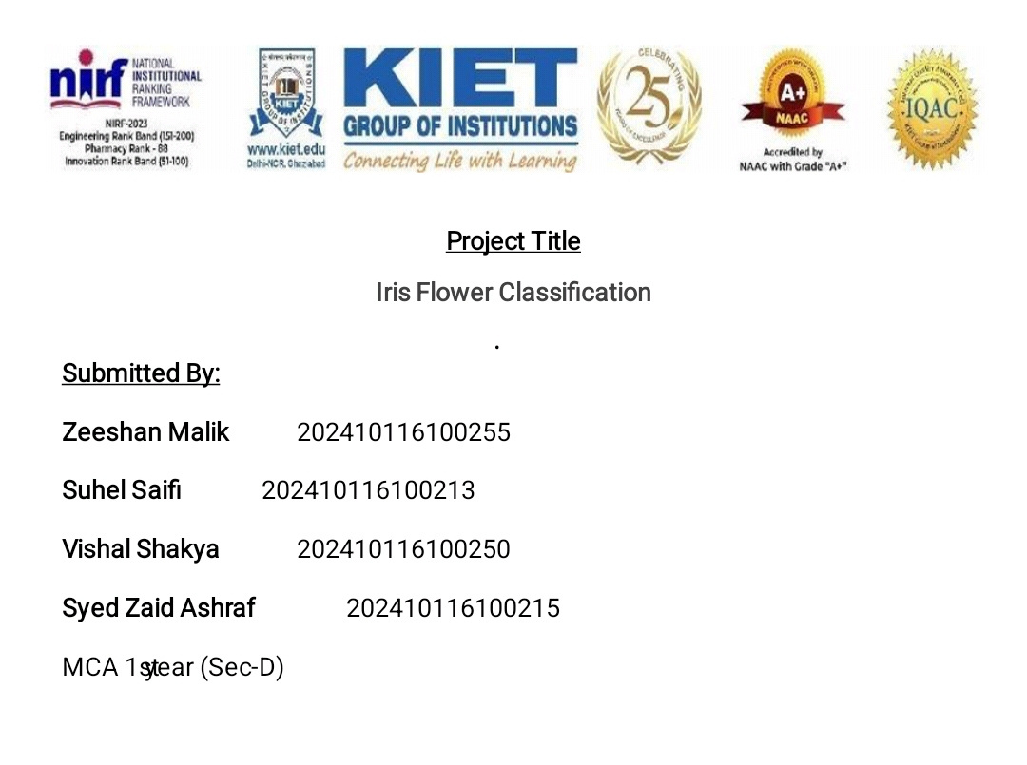
"E-commerce Product Recommendation System"
Introduction to AI (AI101B)

Slide 2
Introduction
E-commerce Product Recommendation System is a type of software or algorithm used by online shopping platforms to suggest products to users based on their preferences, behavior, and interactions.
An E-commerce Product Recommendation System is an intelligent system that analyzes user behavior and product data to suggest personalized items, aiming to enhance user experience and increase sales.
Uses data like browsing history, ratings, purchases
Employs techniques like collaborative filtering, content-based filtering, or hybrid models.
Often powered by machine learning or AI, such as NLP and deep learning models.

Slide 3
Abstract
Addresses scalability and personalization in recommender systems.
Combines collaborative and content-based filtering.
Uses DistilBERT for semantic embedding.
Outperforms traditional models in accuracy and adaptability.

Slide 4
Motivation
Overwhelming product variety in e-commerce.
Need for intelligent systems to simplify decision-making.
Goal: Accurate, real-time personalized product suggestions.

Slide 5
Objectives
Preprocess behavioral and textual data.
Build hybrid model using DistilBERT embeddings.
Evaluate using Precision@K, Recall@K, MRR.
Compare with traditional recommender models.

Slide 6
Literature Review (Summary)
Traditional: CF and CBF (cold start, data sparsity issues).
Deep learning: NCF, Autoencoders, RNNs.
Transformers: BERT and DistilBERT offer deep context understanding.
Research gap: Lightweight, scalable, and interpretable models.

Slide 7
Project Description
Kaggle Amazon Beauty dataset.
Uses DistilBERT for contextual embeddings.
Implements both content-based and hybrid models.
Visualizations: Heatmaps, bar charts, similarity graphs.

Slide 8
Methodology
1. Data Collection: Ratings, metadata, user interactions.
2. Preprocessing: Clean, tokenize, and embed text.
3. Model: Hybrid (DistilBERT + Collaborative Filtering).
4. Evaluation: Precision@K, Recall@K, MRR, nDCG.

Slide 9
Tools and Technologies
Languages: Python
Libraries: Pandas, NumPy, Scikit-learn, Transformers
Frameworks: PyTorch / TensorFlow
Visualization: Seaborn, Matplotlib

Slide 10
Code Implementation
Preprocess & merge ratings and metadata.
Create user-item matrix.
Apply Truncated SVD for dimensionality reduction.
Generate similarity matrix & recommendations.

Slide 11
Future Enhancements
Real-time deployment via APIs.
Multilingual recommendations.
Explainable AI integration.
Advanced models (GNNs, RL).
Continuous retraining and feedback integration.

Slide 12
Conclusion
Effective use of DistilBERT for hybrid recommendation.
Improved accuracy, relevance, and scalability.
Ready for deployment and future extension.

Slide 13


